Slide 1
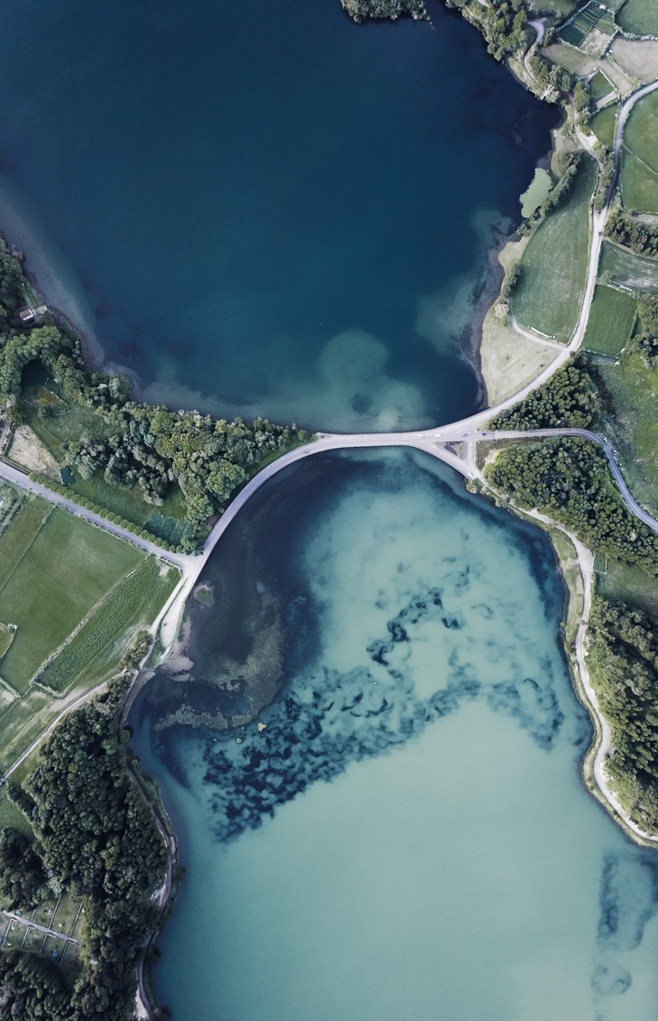
Battle of Neighborhoods - Auberge Beau Sejour
Coursera Capstone Report
By Yves Bourgeois

Slide 2
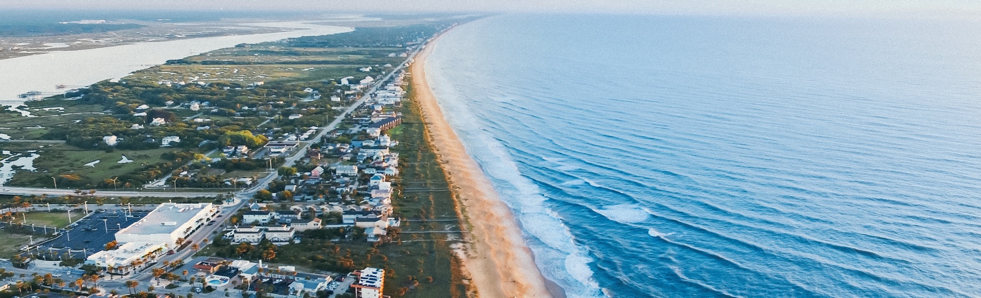
Background
Over the last few years there has been an explosion of AIR-BnB properties popping up across the state of California with no signs of abating. However, there remains a niche market that AirBnB does not compete with directly, namely Bed & Breakfasts. Some travelers prefer the rustic charm of a smaller place to stay and have the opportunity to chat with the owner and locals. They are looking to absorb the local culture and enjoy the outdoors free from unfettered commercialism like Disneyland or SeaWorld.¶

Slide 3
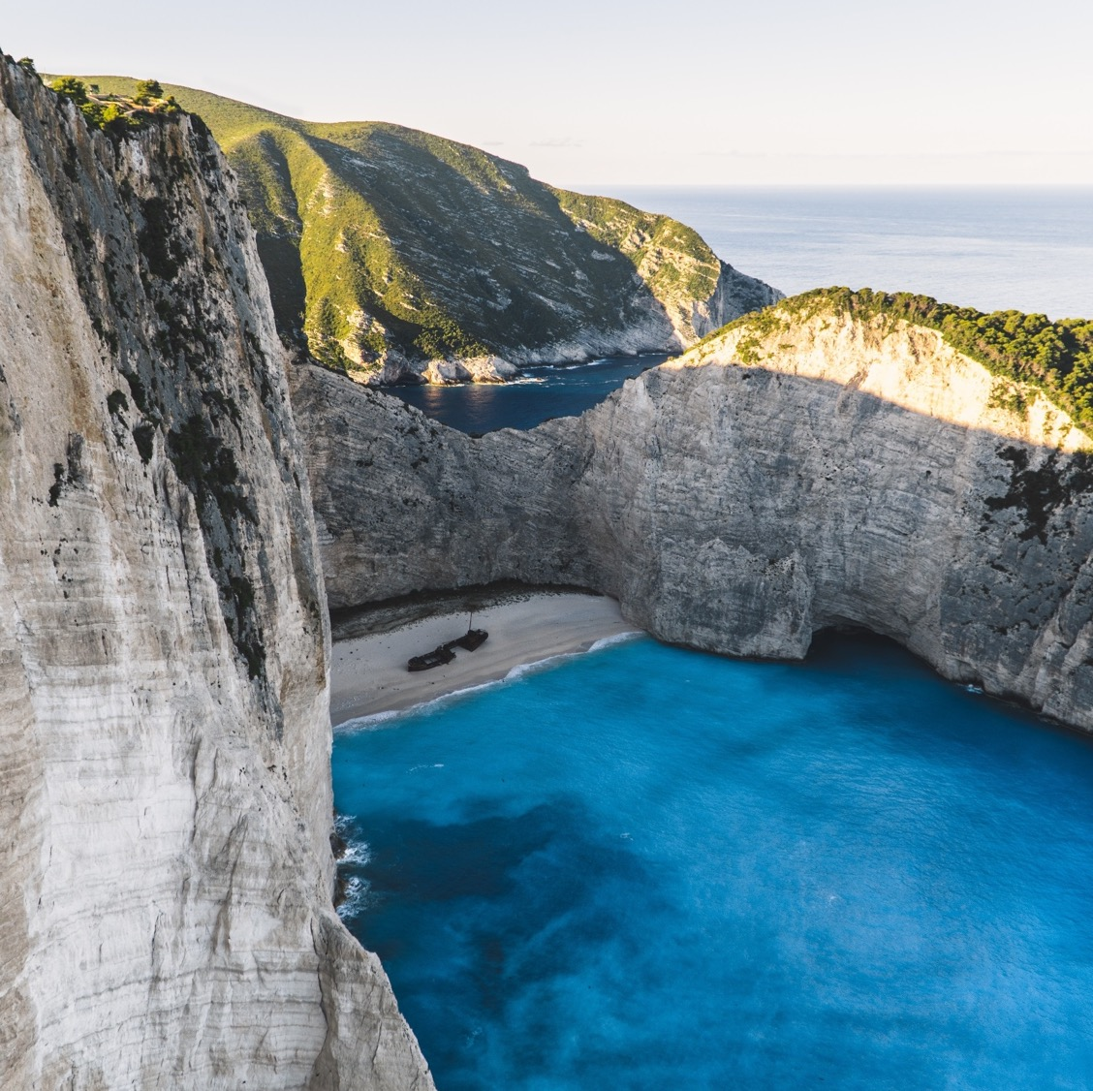
Helping a friend
My friend is an architect and has travelled the world throughout his career and is soon to retire in southern California. He is looking to focus on this niche market and open a luxury Bed & Breakfast and run it as a family business. This will allow him to meet lots of interesting people without having to travel himself. His vision is to open a retreat that focuses on nature and tranquility. The B&B will offer yoga classes, massage therapies, and organic cuisine. He plans on calling it Auberge Beau Sejour

Slide 4
Selection criteria
Preferred venues = beaches, parks, wine tasting rooms & wineries.
County w/ crime rate < state average
City w/ per capita income > $30,000.
Total cost < $4 million.
Location < 2-hour drive to LAX airport.
Close to highway 101, w/ access to beach a higher priority.
Minimum accommodation 6 guests or 4 guest bedrooms. (5th bedroom for owner)¶

Slide 5
Defining the Business Problem
The business problem is centered around finding a piece of real estate that fits all of these criteria.

Slide 6
Project components
Data Sources
Methodology
The key data sources are:
Redfin, Trulia & Zillow: MLS, market analysis & forecasting.
Wikipedia: demographics
Foursquare: venues by city & competitive intelligence
Google maps: driving distances
Chapter 11 covers historical data for median sale price trending.
Chapter 12 cover various forecasting models such as AR, MA and ARIMA.
Chapter 13 will cover the SARIMAX forecasting model.

Slide 7
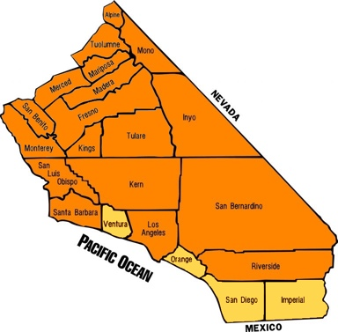
4 counties with the lowest crime rate in California
Based on crime rates in California, 4 counties are now shortlisted 1- Imperial, 2- San Diego, 3- Ventura & 4- Orange (shown in yellow) These counties are close to LAX airport, & most are in close proximity to the ocean. Imperial County is eliminated based on poor proximity to the ocean and LAX.

Slide 8
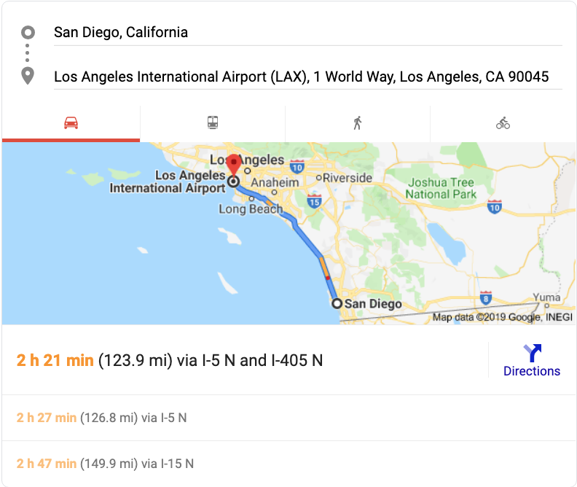
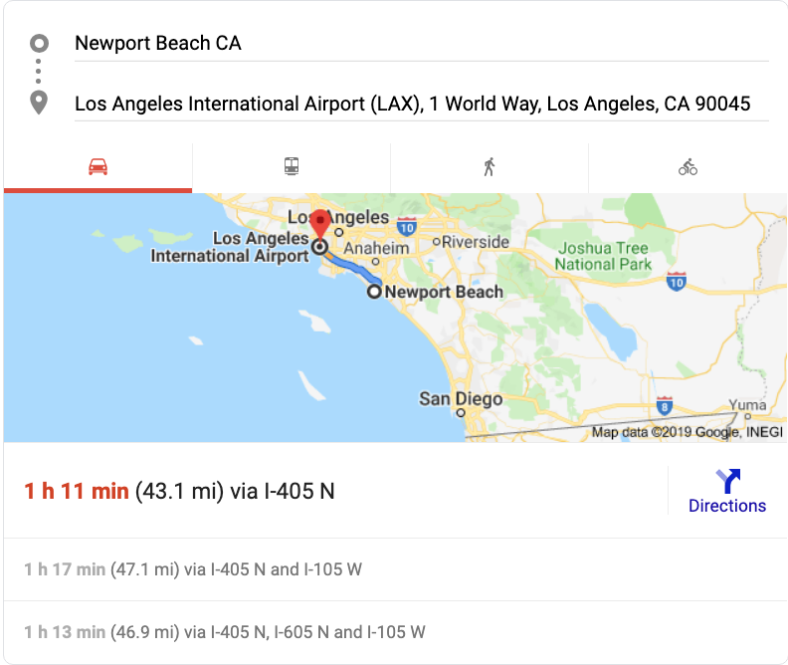
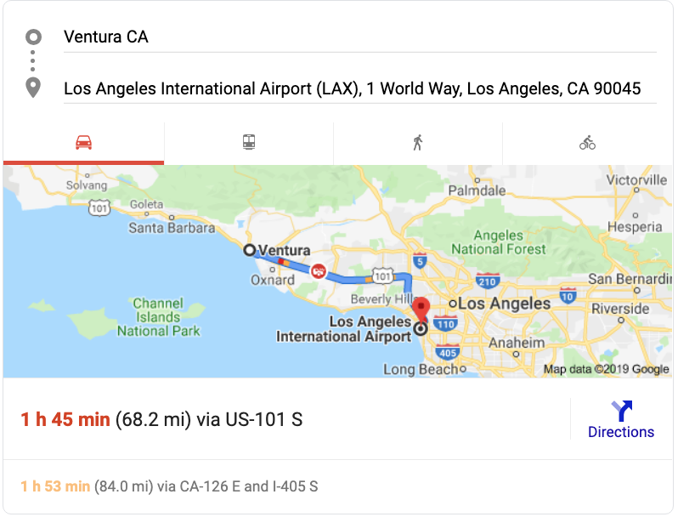
Driving distance to Lax airport
San Diego County drive time to LAX > 2 hours -> eliminated.
Ventura & Orange counties drive time to LAX < 2 hours -> remain.

Slide 9
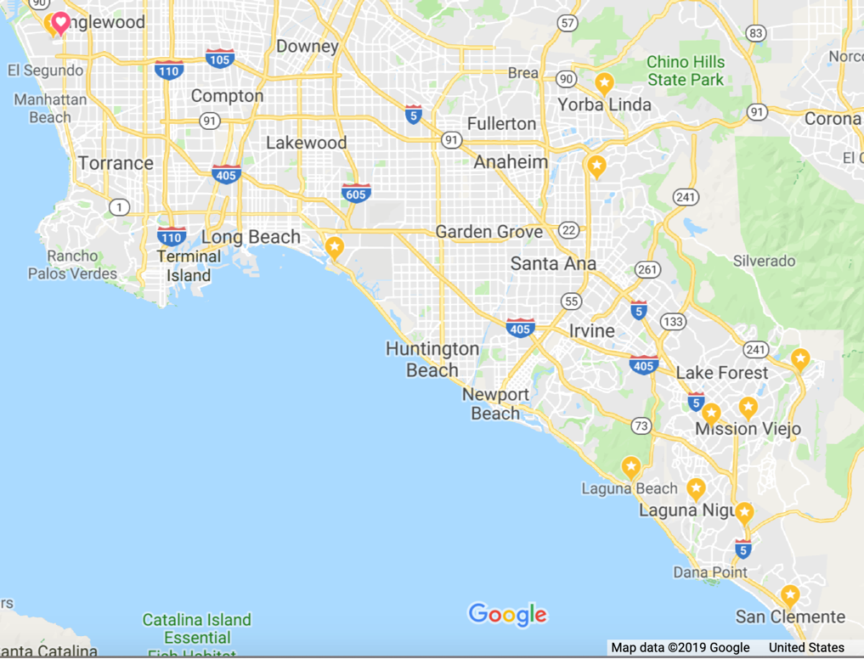
Evaluate the crime rate & Per capita income of cities in each county
Wikipedia: # of cities by county: Ventura: 20 & Orange 34.
Shorten list by using crime rates and per capita income (PCI).
Combining PCI & crime rates, the top 10 cities in Orange county. Heart icon is Los Angeles Int’l Airport (LAX).
City
Laguna Beach
Laguna Hills
Laguna Niguel
Mission Viejo
Rancho Santa Margarita
San Clemente
San Juan Capistrano
Seal Beach
Villa Park
Yorba Linda

Slide 10
Foursquare analysis of city venues
City | # Venues
Laguna Beach | 24
Laguna Hills | 6
Laguna Niguel | 5
Mission Viejo | 1
Rancho Santa Margarita | 11
San Clemente | 38
San Juan Capistrano | 60
Seal Beach | 17
Villa Park | 6
Yorba Linda | 4
Top 5 finalists w/ most venues San Juan Capistrano, San Clemente, Laguna Beach, Seal Beach, Rancho Santa Margarita
Top cities 1- Laguna Beach has a park & beach venues & is close to a wilderness coastal park. 2- San Juan Capistrano has a historic site & winery. It is further from beach, but near wilderness areas
Cities dropped from the list (fewer venues, poor access to beaches & parks) are Rancho San Margarita, Seal Beach, San Clemente

Slide 11
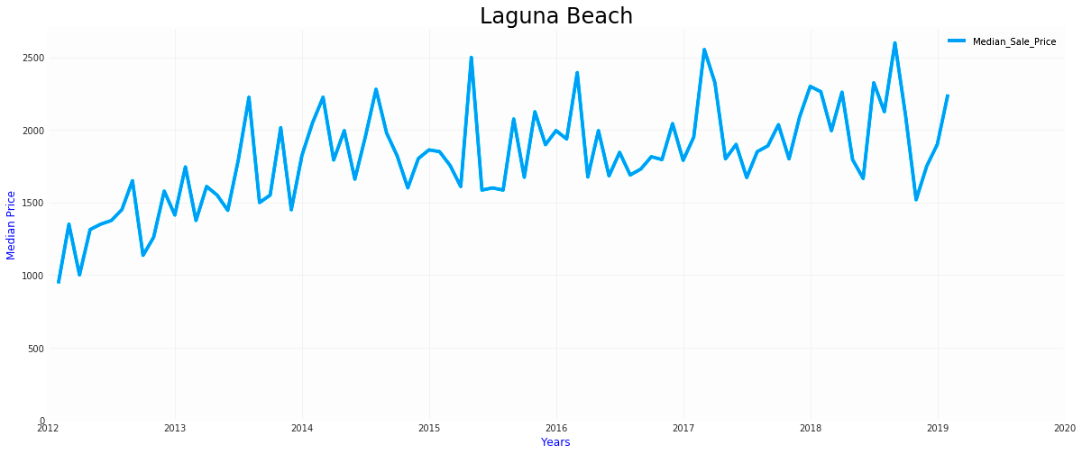
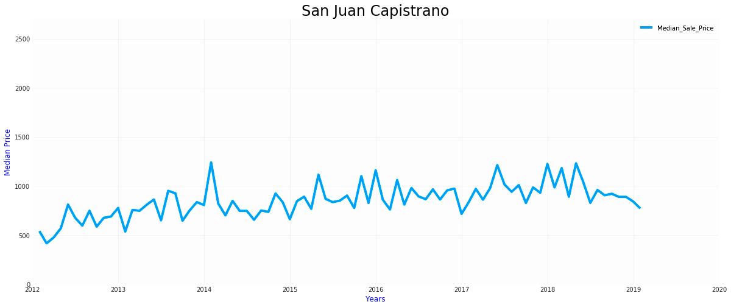
Time series analysis
Laguna Beach median prices > San Juan Capistrano.
Laguna Beach Prices variance > San Juan Capistrano.
San Juan Capistrano's median prices declined vs. Laguna Beach median prices increased.
San Juan Capistrano = opportunity.

Slide 12
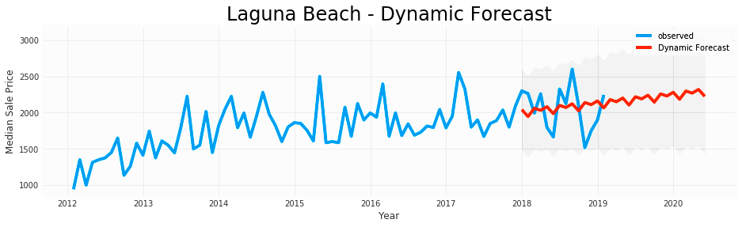
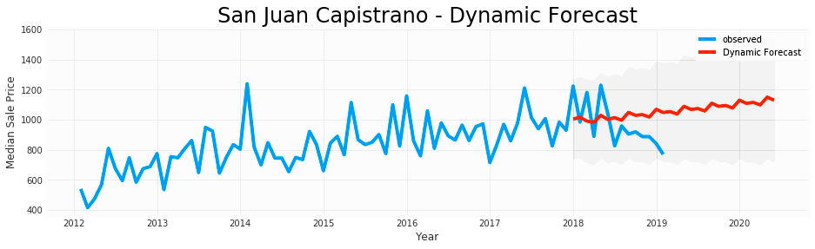
forecast for San Juan Capistrano & laguna beach
Laguna Beach: healthy real estate market w/ prices rising in 2019 & 2020. Close proximity to ocean = expensive. Median sale price is estimated reaching approx. $2.3M in 2020.
Juan Capistrano: healthy real estate market w/ prices climbing in 2020. Recent decline, but median sale prices expected faster rise. Currently a buying opportunity. Median sale price est. approx. $1.1M in 2020. Cheaper than property in Laguna Beach. In short, market favors San Juan Capistrano.

Slide 13
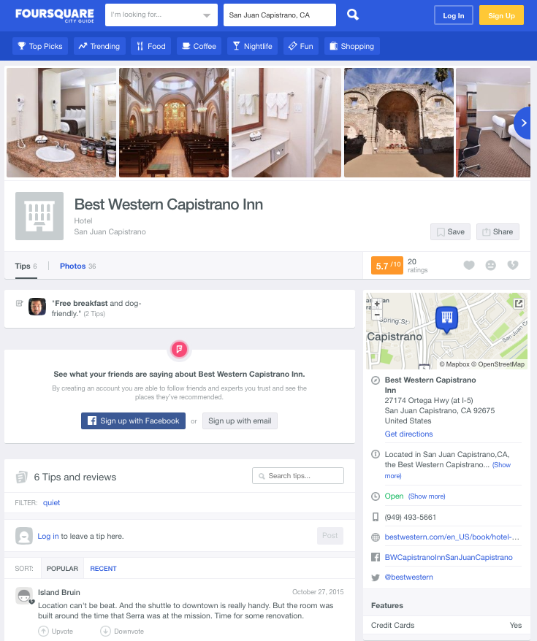
Competitive analysis
Searching Hotel categories, only one competitor, Best Western Capistrano Inn. Foursquare ratings are
5.7 / 10 from 6 responses
Rating is far from stellar.

Slide 14
Evaluate MLS listings
Two properties based on the property criteria:
property-type=house; max-price=4M; min-beds=5; min-baths=5; min;; sqft=5k-sqft; min-parking=5; min-lot-size=1-acre; has-pool
The median prices of home listings < $4M.
San Juan Capistrano median price: declining trend
Laguna Beach is trending upwards.
Median prices:
San Juan Capistrano < Laguna Beach
San Juan Capistrano = winner.

Slide 15

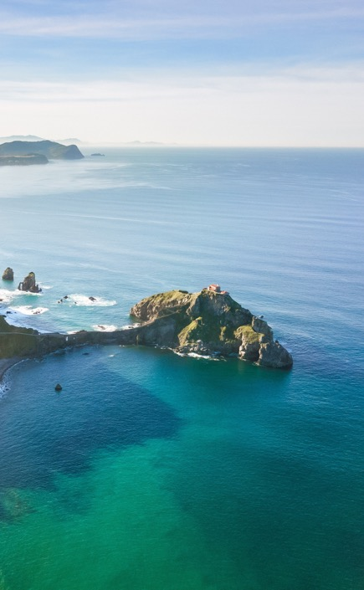
Compare Property Specs of Chosen Properties
Comparing 2 properties: Cook Ln. is the best choice. Property specs are insufficient for final decision. Review pictures & visit properties.
Property | address | zip | price | beds | baths | lot_size | SQFT | MLS #
Single Family | 27902 Via Madrina | 92675 | 3498000 | 5 | 6.00 | 64791 | 417 | OC18268633
Single Family | 32061 Cook Lane Ln S | 92667 | 3250000 | 6 | 6.25 | 43560 | 487 | PW18235467

Slide 16
Summary of Real Estate Market Analysis and Finalists to Establish a B&B
Demographics & Geography
Competitors & Venues
Real Estate
Methodology
--Web scraping Wikipedia, Google Maps
In the final analysis, the house on Cook Lane offers the best value investment overall.
--Venue mapping of cities
--Statistical models, Comparison of MLS listings

Slide 17
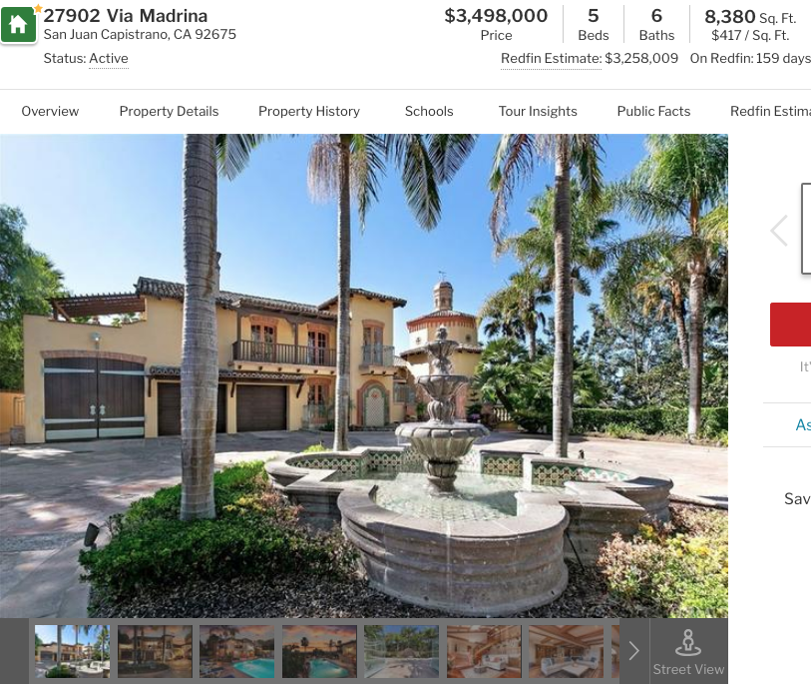
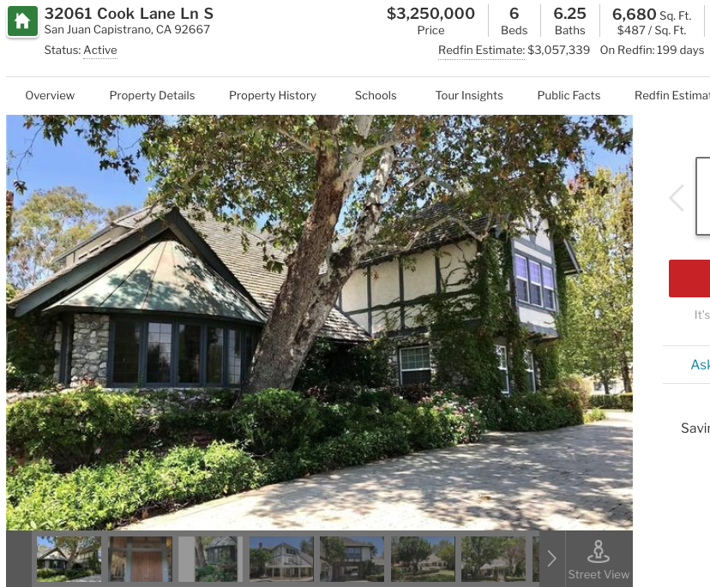
Discussion on Further research
Analyze risks with city planning, zoning laws & property taxes. Apply predictive analytics to them.
California always requires earthquake assessments. Use Folium & geospatial earthquake data to review risk levels by location.
Working with real estate agent to access MLS real estate data & perform MLS data clustering analysis.

Slide 18
Thank You
bringideas2market@gmail.com
Github
https://github.com/ybourgeo64/YB-Portfolio

